Slide 1
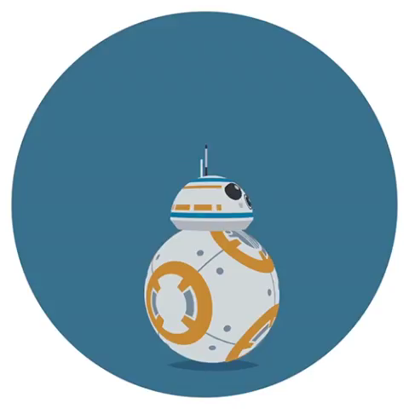
Duke Tutor Mobile App
Team name: BB8
Final presentation

Slide 2
Content
Overview
Plan Updating
Demo
Project test

Slide 3
Overview --- User story
Registration
Post class
Search class
Make confirmation
Feedback
Notes:
What is out app? Why we need it?
In duke, there are super talented people gathering,
Many people have special skills.
Durham is small, not enough resources available
Suppose you want to learn Tai Chi……
So our app helps match peer tutors with peer tutees at ease
The procedure of how our app works is like this:
Registration
Profile: Identity, interested fields and available time, post a listing with a subject/time/location of a tutoring session
Set up the filter to search other tutors' offerings from the nearest ones.
The tutor and tutee will discuss and decide the final time and location to meet, after they make a confirmation, the system will record it.
After a tutoring session, the tutee could leave feedback and this will appear on the tutor’s profile for others’ reference.

Slide 4
Plan Updating
Major change 1: Sprint change
Major change 2: Change some requirements
1. Change conversation to message
2. Payment system deleted
Major change 3: Add some requirements
1. delete session
2. layout: flat activity ----> navigation

Slide 5
Plan updating
Feb. 19 – Mar. 4
Sprint 1
Study basics of Java and Android Studio
Registration and Profile collection
Mar. 5 – Apr. 2
Sprint 2
Searching engine, message module
Scalability and load balance
Apr. 3 – Apr. 15
Sprint 3
User manual
Feedback system
User tutor class page
Fragment view
Message communication
Profile view

Slide 6
Project test
Unit test
Component test
System test

Slide 7
Unit test
Front end:
Use Android Studio’s local unit test and instrumented unit test module
Verification test: All the components are successfully generated, data are successfully exchanged.
Validation test: user input information in correct format.
Back end:
Use Python's unit test module.
Verification test: models are correctly generated and stored.
Validation test: Generate error message for invalid fields in a model.

Slide 8
Component test
We combine frontend and backend testing here.
For each component,
Test the basic functionality of the component
Test when input information is invalid or empty
Check if exception is thrown as expected

Slide 9
System Test
Use two android cellphones to work as a tutor and tutee. Test the functionality of whole system. Using these two accounts, to see if there is any incompatible features.

Slide 10
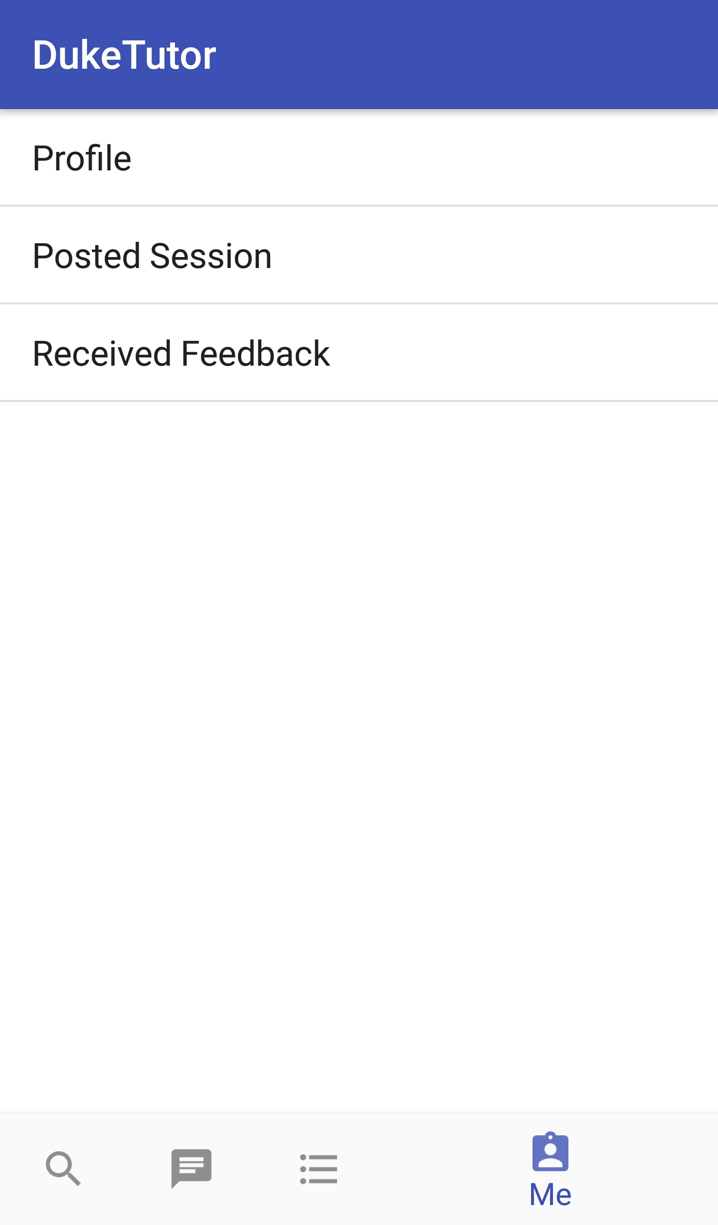
Demo
Registration and Login
Post session
Search for session
Apply for session
Check message
Confirm session
Delete session
Leave feedback and rating
Notes:
So our recent work mainly includes three parts:
I have to admit that we are falling behind our plan, mainly because I and my
teammates are overloaded with assignments and projects in the recent week.
(I think some of you may have the same feeling.)
So the first thing I can talk about is
1) Learn Java. which has started since homework one, but will continue throughout the project. Currently all of us has JDK installed on our laptops and know
how to compile a Java project.
2) Frontend development. Since we are developing an Android app, we will use
Android Studio as our development envrionment. As of now, two of us have
Android Studio installed, since two of us will be concentrated on frontend
and the other two on backend development.
We can now compile an demo App with Android Studio and run on a simulator or
a phone.
3) Backend development. We will use Java for backend development. But there
are several frameworks out there and we have not decided which one to use.
We think we should talk about this with the TA.

Slide 11
Highlighted Logic:
Search: match words in session title and description
Acceptance: only one tutee for one session
Application: duplicate application are ignored
Session Detail Page: Edit, Apply or Rate(to give feedback)
On deleting a session: those who applied will receive notification
Navigation Bar: utilizing fragments and BackStack

Slide 12
Thank you!

